Slide 1
ATB (RFE) ES1->ES2 change log tickets

Slide 2
Ticket list ; ES1->ES2 changes
Id | Title | severity | status | Comments | Change Category
artf935413 | [ATB ADC] First reading is not reliable and needs to be discarded | Minor | closed | RTL fix. (verified OK) | Digital
artf905083 (artf981576 artf981582 artf981648 artf1014865) artf807405 | ES2 Improvement - ChirpPLL-> AC ATB Vtune measurement | Medium | closed (closed closed closed closed) verifying | New Vtune buffer introduced at RFE top , along with chirp IP changes in loop filter cell | Analog schematic , interface , layout , specification
artf941865 | DC bus of ATB1_n always pulled down to ground | Severe | closed | New TDC IP release which doesn’t have a hard connect to ground on vtrim_n node | Analog schematic , layout
artf984429 | ATB-ADC and TX ADC Trim Verify at DIFF mode | Medium | Analyzed | Fuse map and Trimming methodology updated – test program update awaited | Test procedure , OTP map , SW
artf900604 | [RFE_DFT] XOR output for ATB_ADC cannot be brought out because of wrong scan clamp for ena_bg | Medium | Validating | Reg map updated - ena_bg scan clamp value=1 separate control bits for vstress enables of bg and adc(ldo_bypass) | Analog schematic , interface , layout , Digital , Reg map

Slide 3
Ticket list ; ES1->ES2 changes
Id | Title | severity | status | Comments | Change Category
artf947765 | [ATB ADC] DIV2 mode doesn't work for higher sampling rates | Medium | verifying | Spec update for max freq of operation in DIV2 mode | specification
artf937969 | ATB ADC conversion ready to be mapped as part of the debug signals | Medium | closed | RTL fix | Digital
artf863440 | 1572151->The IF analog buffer shall have a linearity (IM3) better than >73DBc | Medium | closed | Spec update to specify conditions | specification
artf909585 | RX- channel to channel gain/phase imbalance spec (in ATB path) not met | Minor | closed | Spec update in Doors to relax | specification
artf935448 | ATB 10b-ADC offset trimming need more bits in the OTP | Medium | Solving | Fuse map updated – SW implementation update pending | OTP map , SW
artf890224 | Updated Reset Defaults of Bandgap IP Trims , not available in Current Design | Medium | closed | Reg map update for BG trims | Reg map , digital

Slide 4
ES1 -> ES2 changes | (high level) Description of changes
Interface changes? | Slide #5
Schematic/layout changes? | Slide #6
Specification changes? | Slide #7
Power up/ power down sequence changes? | Slide #8
Test procedure changes ? | Slide #9
Special Notes?

Slide 5
Interface changes
Ticket ID | High level change description
artf905083 | New Vtune buffer cell added in ES2 design , corresponding enable register field coming from digital is : ATB1_AC_SWITCHES_1 . ATB1_VTUNE_EN
artf900604 | Previously in ES1 the same stress bit was used for ATB BG and ATB ADCs , in ES2 they are separate. The respective registers are - VSTRESS_EN_VSTRESS_BG VSTRESS_EN_VSTRESS_ADC

Slide 6
Schematic / layout change
Ticket ID | High level change description
artf905083 | For monitoring the chirp Vtune on external ATB debug pins/ via RX-ADC , a vtune buffer was added in ES2 design for SE to diff conversion , attenuation , etc of Vtune. This buffer is part of ATB library but sits on RFE top near chirpPLL as a standalone cell . The buffer derives its supplies and levelshifted controls from ATB(RFE) and is part of the AC-ATB subsystem.
artf900604 | Previously in ES1 the same stress bit was used for ATB BG and ATB ADCs , in ES2 they are separate , as it gives us more control on independent stressing of different power domains , and scan testing of ADC . The respective stress registers for BG and ADCs are - VSTRESS_EN_VSTRESS_BG VSTRESS_EN_VSTRESS_ADC
NA | Layout improvements / optimizations inside ATB cell ( symmetry between ac input lines of both AC ATBs , etc. )

Slide 7
Specification change / additions
Ticket ID | High level change description
artf905083 | Specs added in Doors to cover the requirements for Vtune buffer (new in ES2 ) - changeset related to artf981648 . RS IDs – complete list in next slide
artf947765 | Div by 2 mode of ATB-ADCs do not work at higher clk frequencies ( 4MHz , 5MHz) reliably due to IP limitation . Spec changed to clarify operating frequency as 2.5MHz for Div/2 mode of ADCs. RS ID - 3041447
artf863440 | AC ATB IF analog buffer linearity (IM3) spec relaxed , as in forward path from RX IFBIST , the full-scale mode is not used. RS ID - 1308889
artf909585 | RX- channel to channel gain/phase imbalance spec relaxed as the unavoidable asymmetry between the RXs on RFE top were creating more imbalance than previous spec. RS ID - 1344147 , 1344148

Slide 8
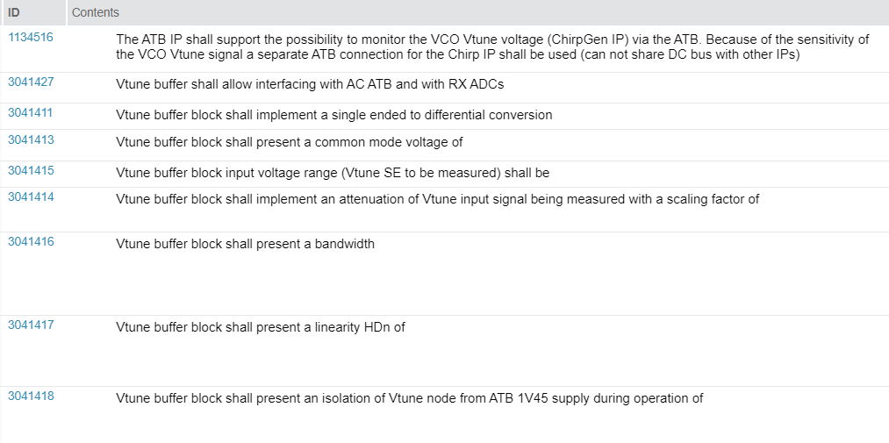
New RS IDs for chirp-ATB vtune buffer (1/2)

Slide 9
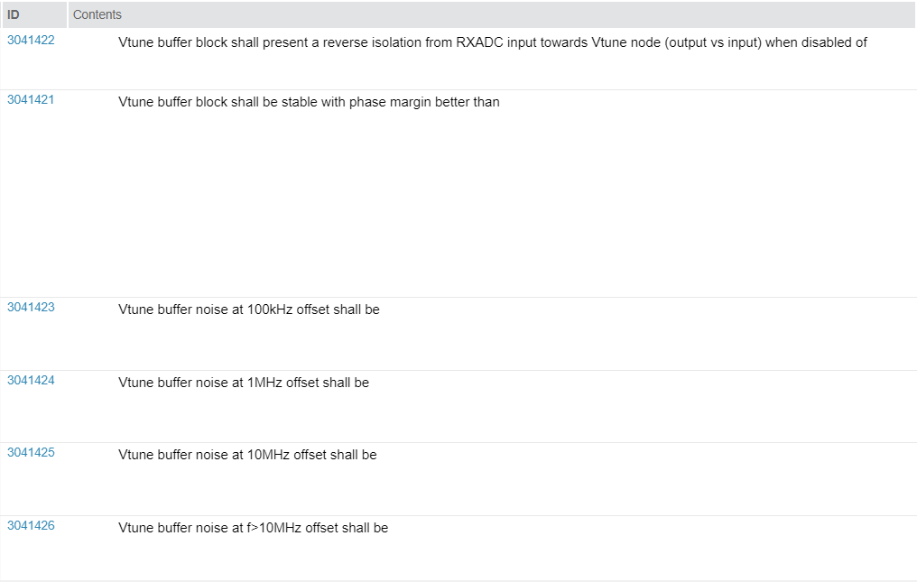
New RS IDs for chirp-ATB vtune buffer (2/2)

Slide 10
Power up / down changes
No change in top level power up , standby , power down sequences
For new addition of Vtune buffer, the recommended sequence ( for SoA reasons )
1. Enable ATB Vtune buffer (ATB. ATB1_AC_SWITCHES_1 . ATB1_VTUNE_EN )
2. Enable chirp side switch for Vtune propagation (CHIRPPLL.ATB_AC.CHIRP_VTUNE_SEL )

Slide 11
Test procedure/ SW changes ?
Ticket ID | High level change description
artf984429 | Owing to the silicon observation that the ADCIP has different inborn offset and gain errors in SE and diff mode , new fields were added in OTP fuse map for correction factors of diff mode . This implies that the test program needs to be updated to compute correction factors separately in SE and diff modes. And any API post processing of raw ADC data needs to consider appropriate correction factors from OTP Refer tab Of trimming document for latest procedure -
artf947765 | Div by 2 mode of ATB ADC to be used with lowest adc clk frequency ( 2.5MHz setting )

